Slide 1
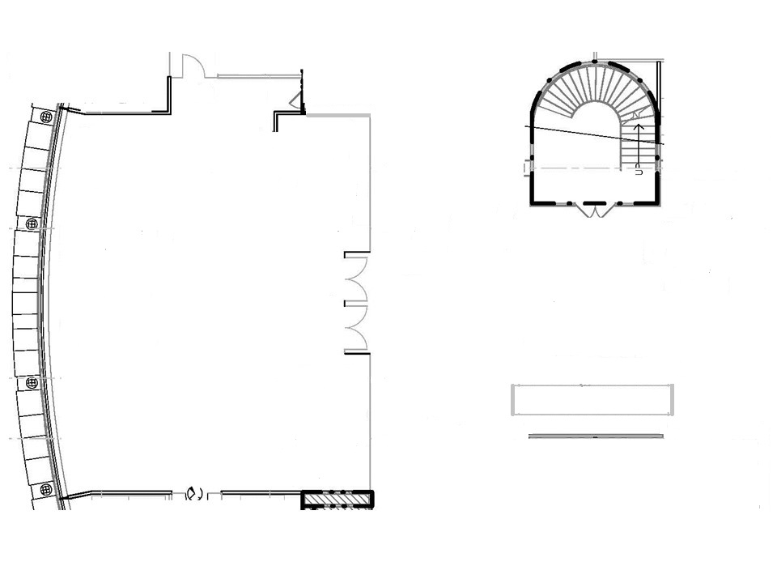
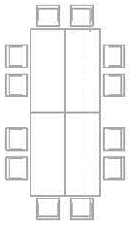
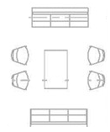
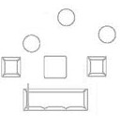
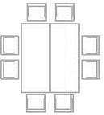
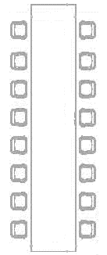
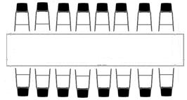

Slide 2
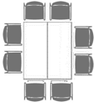
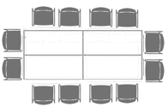
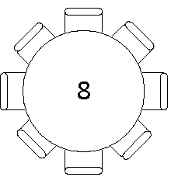
Original Commons Couch area Set-up as One Unit
Commons Study Chair (Unit of 8)
Commons Study Chair (Unit of 6)
Commons Original Orange Chairs with Screens (One Unit)
Commons Study Chair (Unit of 4)
Commons Couch
Commons Study Chair (Unit of 2)
Commons Orange Chairs of Three (One Unit)
Commons Coffee Table
Commons Study Chair
Commons Orange Chairs
Commons Chairs in the Couch area
Commons Coffee Table near Orange Chairs
Screens (One Unit)
2nd Commons Table/Chairs Set-up (One Unit)
3rd Commons Table/Chairs Set-up (One Unit)
Commons Study Table
THE COMMONS FURNITURE
1st Commons Table/Chairs Set-up (One Unit)
EVENTS
BSL Bar Table used for bar, food, or both
THE BLUE SKY LOUNGE FURNITURE
Podium
High Top
Original BSL Couch area Set-up as One Unit
Events: Round with 8 Chairs
Commons Study Table used for bar, food, or registration
BSL Bar Table with Chairs
BSL Coffee Table
BSL Chair
BSL High Top Stool
BSL Orange Fabric Stool
BSL Couch
Commons Table/Chairs Set-up (One Unit)

